Slide 1
Statistics Case Study
Group-12​

Slide 2
AGENDA
Introduction​
Dataset
Code
​Summary​

Slide 3
Introduction
Today , nearly each and every home in Indian Families have at least one member is suffering from diabetes. So we have performed Case Study Analysis over the Diabetes causes and reasons. Also the dataset is consisting of some other factors which we will discuss.

Slide 4
Dataset
Diabetes Prediction Dataset

Slide 5
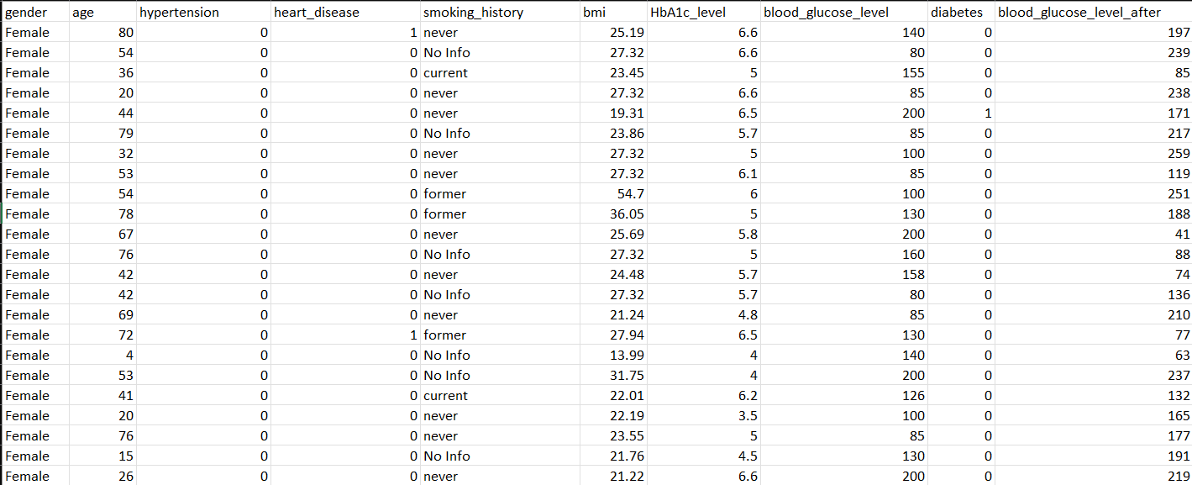
Actual dataset preview

Slide 6
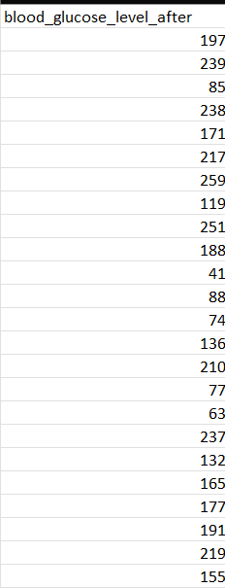
Modified Data

Slide 7
Code

Slide 8
SUMMARY

Slide 9
THANK YOU

